Slide 1

Installing the validation pipeline and associated tools
Dynaωo validation pipeline: installation
Training Session
February 17, 2022

Slide 2
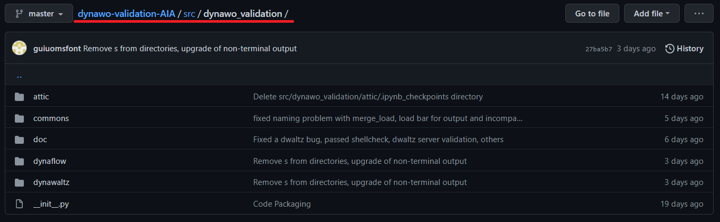
Introduction to the Python Package
Source code now restructured in three main parts:
Dynawaltz validation
Dynaflow validation
Common utilities
And it is intended to be installed as a Python package (via pip)
Readmes for the installation:
dynawo-validation-AIA/src/dynawo_validation/doc

Slide 3
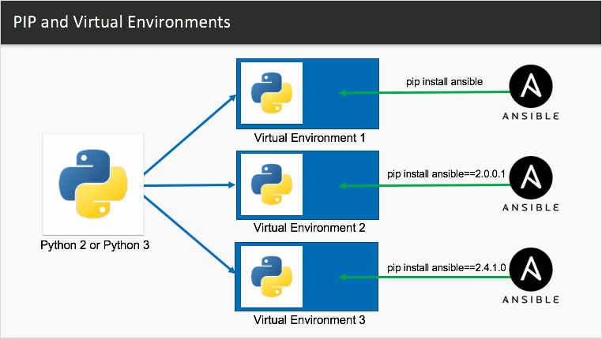
Why do we recommend using a Python VENV?
What is a Python virtual environment?
A venv is a lightweight “virtual environment” with its own private “site” directories (python packages), isolated from the operating system’s site directories. Each virtual environment has its own Python binary + standard lib; the idea is to install here an independent set of installed Python packages in its site directories.

Slide 4
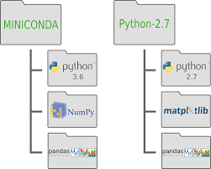
Why do we recommend using a Python VENV?
Why do we use a venv?
It is considered a Python best practice for solving “dependency hell” problems. It also frees the user from having to request the sysadmin to install additional packages system-wide on the OS.
https://docs.python.org/3/library/venv.html
Dependency hell example: you already have package A, which depends on package Z version <=1.3. Now you need to install package B, which also depends on package Z but version =>1.5. You can’t have both A & B!!!
The strategy with venvs is to have a minimal base system in the OS, and then project-specific packages in the venv

Slide 5
1st - Preparation of the OS and base tools (needs root)
Install the base OS: Debian 11 (or any other recent Linux distribution)
Non-Python: install these packages:
apt-get install git parallel
Python: install or verify that Python (the base system) is installed:
apt-get install python3.9
Python: install these additional packages, pip & venv:
apt-get install python3-venv python3-pip
This is the absolute minimum Python environment required in the OS.
Very important for running simulations in parallel

Slide 6
2nd - Creation of the virtual environment
All the steps shown below can be done automatically through the shell script "build_and_install.sh" found in the root of the repository.
Create a venv:
python3 -m venv /path/to/new/virtual/environment
Activate this venv:
source /path/to/new/virtual/environment/bin/activate
The prompt changes: you should see the name of your virtual environment in parentheses before your usual command line prompt.
Upgrade pip (always do this before installing anything in your venv):
pip install --upgrade pip
Other:
- To deactivate the virtual environment: deactivate
- To remove the virtual environment: rm -rf /path/to/new/virtual/environment

Slide 7
3rd - package creation (venv should be activated!!!)
If you are a developer, this would be your typical workflow:
0 - You need to install and regularly upgrade pip & friends in your venv:
pip install --upgrade pip wheel setuptools build
1 - Clone the repo:
git clone https://github.com/dynawo/dynawo-validation-AIA
2 - Build the package (go to the main directory of the package):
python -m build
3 - Install the package:
pip install dist/dynawo_validation_RTE_AIA-0.0.1-py3-none-any.whl
But if you are just a user of the software, all these steps will simply be replaced by:
pip install dynawo_validation_RTE_AIA-0.0.1-py3-none-any.whl
(in the future, the package will be made available on PyPI)

Slide 8
4th-JUPYTER CONFIGURATION (venv should be activated!!!)
Registering the widgets
The Jupyter Notebooks use several “widgets”. These widgets need to be registered with the installation of Jupyter Notebook. Usually, for most modern packages, this registration process takes place automatically when the package (e.g. Plotly) gets installed with pip. However, if for whatever reason they do not get properly registered, you can do this yourself:
jupyter nbextension enable --py --sys-prefix qgrid
jupyter nbextension enable --py --sys-prefix ipydatagrid
[Note: to list all enabled extensions, use: jupyter nbextension list]
Jupyter Kernels
Similarly, the installation of Jupyter under the venv should automatically configure things to use the venv Python kernel. If this doesn’t happen, you can manually manage this in two steps:
pip install ipykernel
python -m ipykernel install --user --name=NAME-OF-INTERPRETER
Finally, run Jupyter (jupyter notebook) and, in Kernel Options, select your new Kernel.

Slide 9
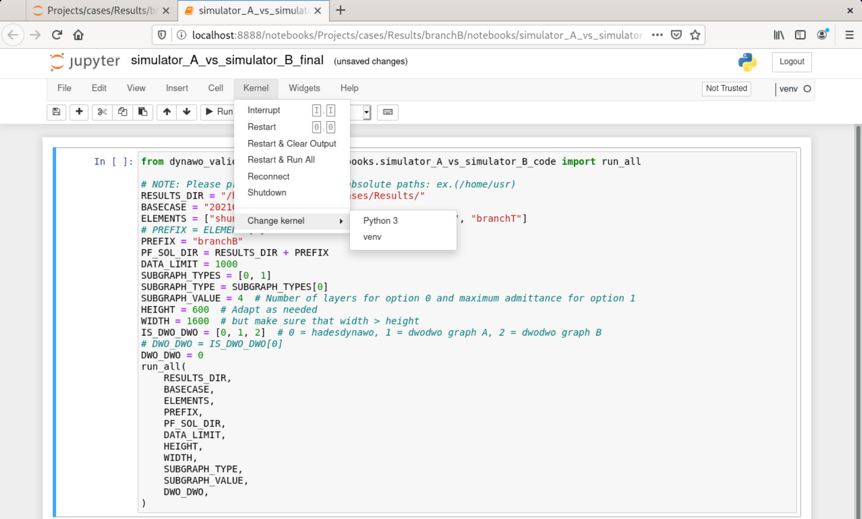

Slide 10
5th - Enjoy it (venv should be activated)
WE ASSUME THAT DYNAWO, HADES, AND ASTRE ARE INSTALLED!
Once installed, several executables for the command line will have been added to your system:
MAIN ENTRY POINTS:
- dynawaltz_run_validation
- dynaflow_run_validation
UTILITIES:
- dynawo_validation_extract_bus
- dynawo_validation_find_path
- create_graph.py
- convert_dwaltz2dwoAdwoB_all.sh
- convert_dflow2dwoAdwoB_all.sh
- xml_format_dir.sh

Slide 11
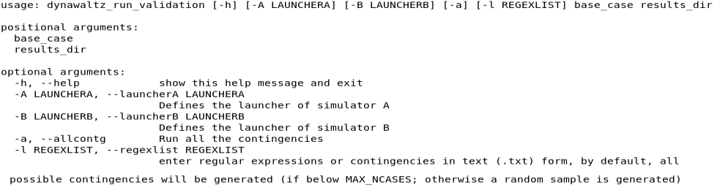
5th - Enjoy it (venv should be activated)
dynawaltz_run_validation / dynaflow_run_validation
It is the main utility and serves to run the pipeline of the two simulators. They leave a notebook file in the results directory.
WARNING: the launchers A and B need to be somewhere on your $PATH. You can’t rely on using relative paths from the directory where you’re running the pipeline (because the scripts “cd” into other subdirectories when executing simulations). If they are not, a clean and quick fix consists in symlinking them to your venv bin directory, which is for sure in your $PATH.

Slide 12
5th - Enjoy it (venv should be activated)
dynawaltz_run_validation / dynaflow_run_validation
The pipeline leaves the results organized under a directory structure like this.
notebooks: contains the notebook for data analysis and exploration
pf_sol: contains the extracted power-flow solutions
Aut: contains the extracted automata events
pf_metrics: contain the calculated metrics
casediffs: you can easily reconstruct any contingency test case with these, using patch
crv: curves outputs, in case you defined these
log: logs from all simulations
xml: the “raw” outputs (IIDM, timelines, etc.) from simulations
Top_10_diffs_*.txt (at top level): ASCII reports
MyResults
├── 20210614_2215a.BASECASE
│ ├── Hades
│ └── recollement_summer_Diagram
├── branchB
│ ├── aut
│ ├── casediffs
│ ├── crv
│ ├── log
│ ├── notebooks
│ ├── pf_metrics
│ ├── pf_sol
│ └── xml
├── gen
│ ├── aut
│ ├── casediffs
│ ├── crv
│ ├── log
│ ├── notebooks
│ ├── pf_metrics
│ ├── pf_sol
│ └── xml
├── load
│ ├── aut
│ ├── casediffs
│ ├── crv
│ ├── log
│ ├── notebooks
. . . ETC.

